Slide 1
WORLD HAPPINESS REPORT
Team: Aditya Chopra, Benson Yu, David Ueda, Dhruv Gandhi

Slide 2
Backstory
Group members have backgrounds from different parts of the world
Encouraged us to ponder about differences in the world which can be measured through data
We came across the ‘World Happiness Report’ Dataset and wondered which parameters would affect happiness the most and if these measurements could draw predictions accurately.

Slide 3
Problem Statement
Our goal was to construct different models to analyze the happiness scores of different countries and experiment to what extent happiness can be predicted
Model’s Constructed:
Linear Regression Modeling
KNN Classification Modeling

Slide 4
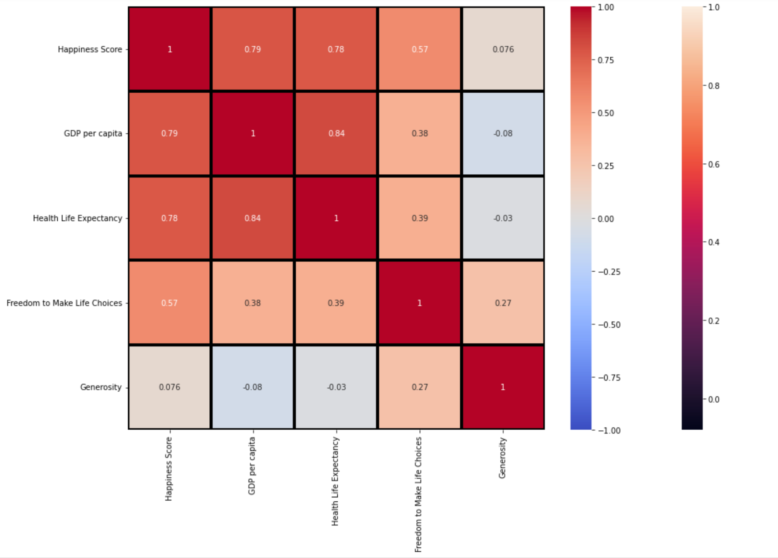
Methods

Slide 5
Methods
KNN Classification Modeling
Linear Regression Modeling
Using the 2016 data, which included the Regional Indicator column for each country. We classified the data by region to find a score by its characteristics and find the train accuracy of the dataset.
Using the 4 parameters (GDP, Life Expectancy, Freedom and Generosity) we trained 70% of the 2019 data to predict the happiness score of the rest of the data, then compare our results to the actual values.

Slide 6
Challenge
Concatenation of Data
Problem:
Solution:
Since we were using data from 2015-2019, we needed to decide how best to concatenate it for training. Duplicates and extremely close values for the same country in different years could lead to inaccurate predictions
After recognizing that simply averaging data from each year would not bring desired results, we realized that our only option was to take individual years for each of our models

Slide 7
Results
KNN Classification
Linear Regression
80%
64%
With an accuracy of 80%, the KNN classification model was fairly accurate in predicting the happiness score for each region
Using the scoring method within the sklearn library, the linear regression model had a score of about 64%

Slide 8
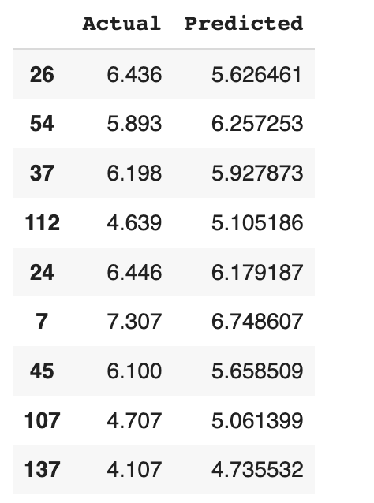
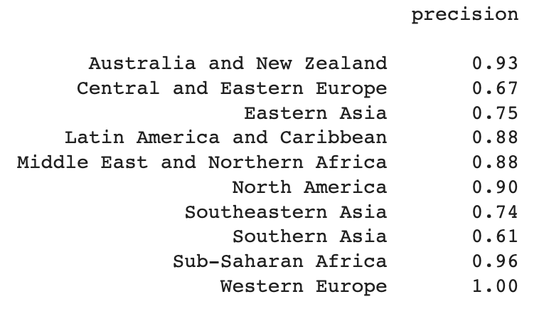
Results
KNN Classification
Linear Regression

Slide 9
Conclusion
Hard to predict happiness with only 4 parameters, more parameters would allow for higher accuracy
Although correlation did exists between the parameters and happiness score, from our results it is clear that there is no direct relationship
From year to year, happiness scores do not generally change significantly

Slide 10
Fun Fact!
Happiness has almost no correlation with people’s generosity in a country!

